Slide 1
Houston Housing

Slide 2
Property Value
Graph
Data sources/methodology
Limitations of dataset
Assumptions
Insights/trends

Slide 3
Crime trends

Slide 4
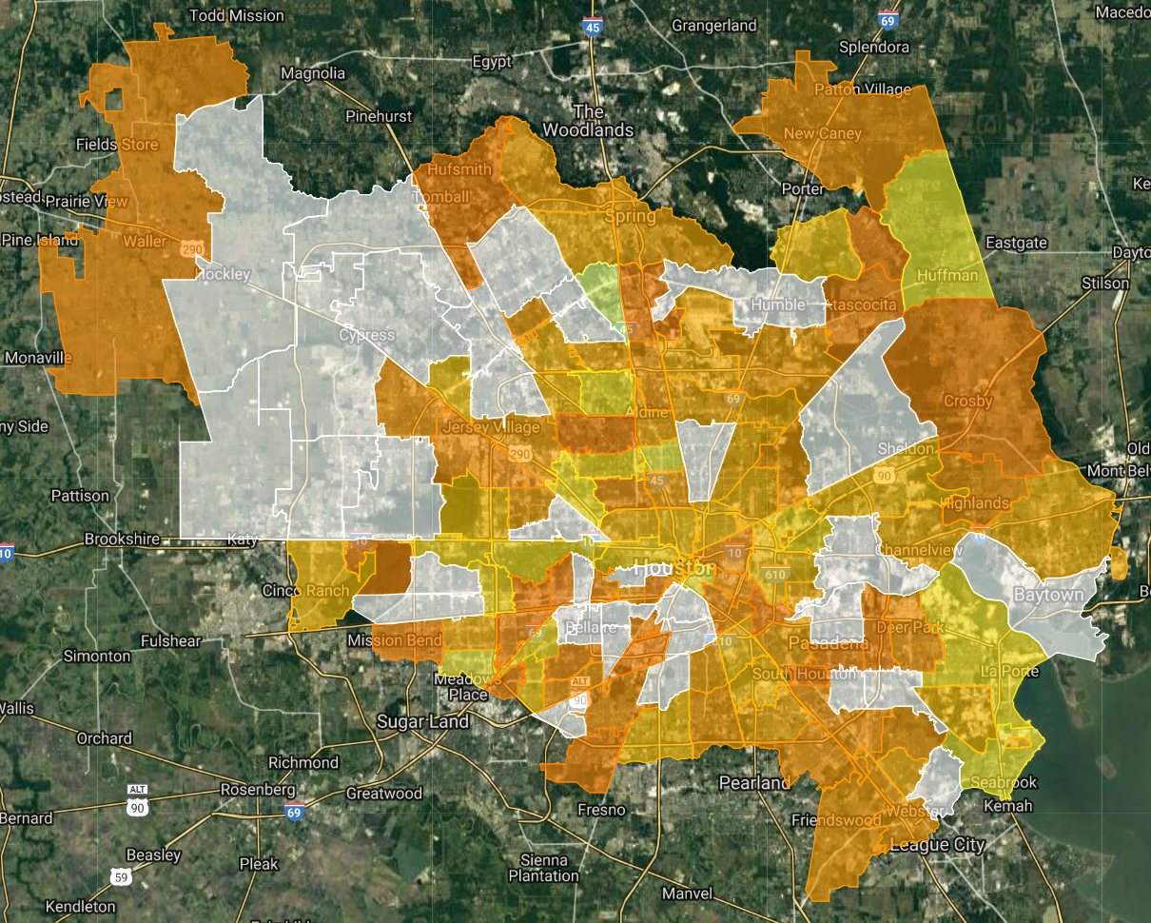
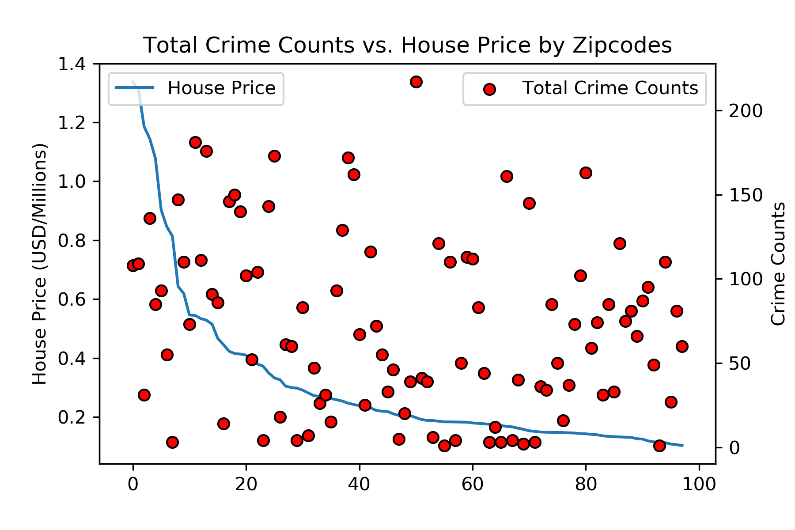
Crime Distribution by Zipcode
No obvious correlation (R² = 0.20)

Slide 5
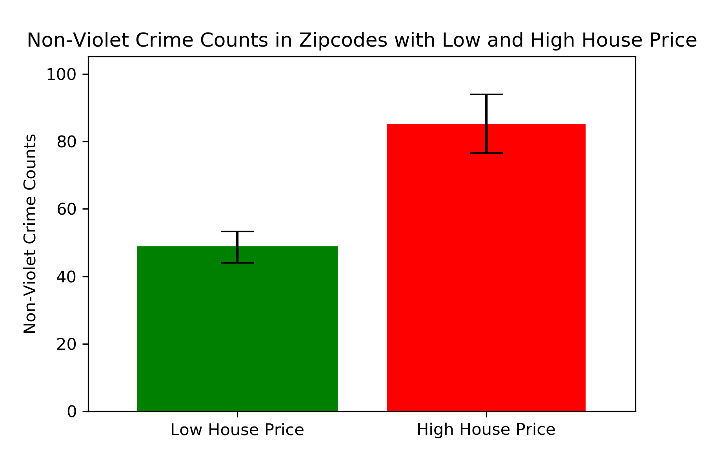
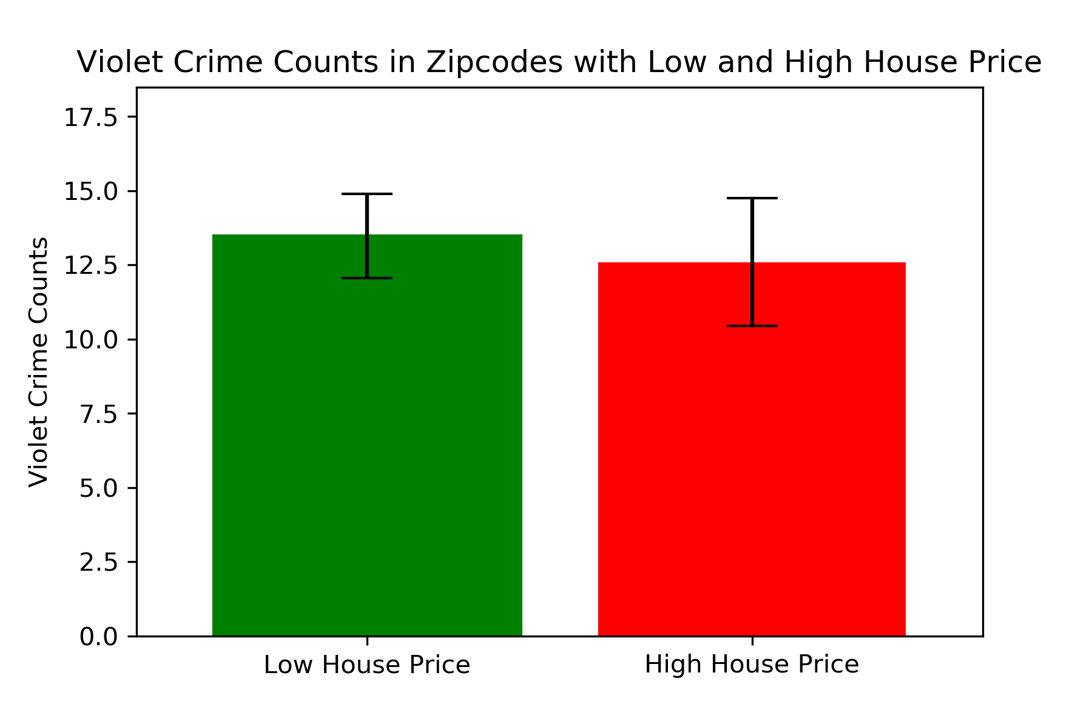
Crime Categories Impacted by House Price

Slide 6
Flood trends

Slide 7
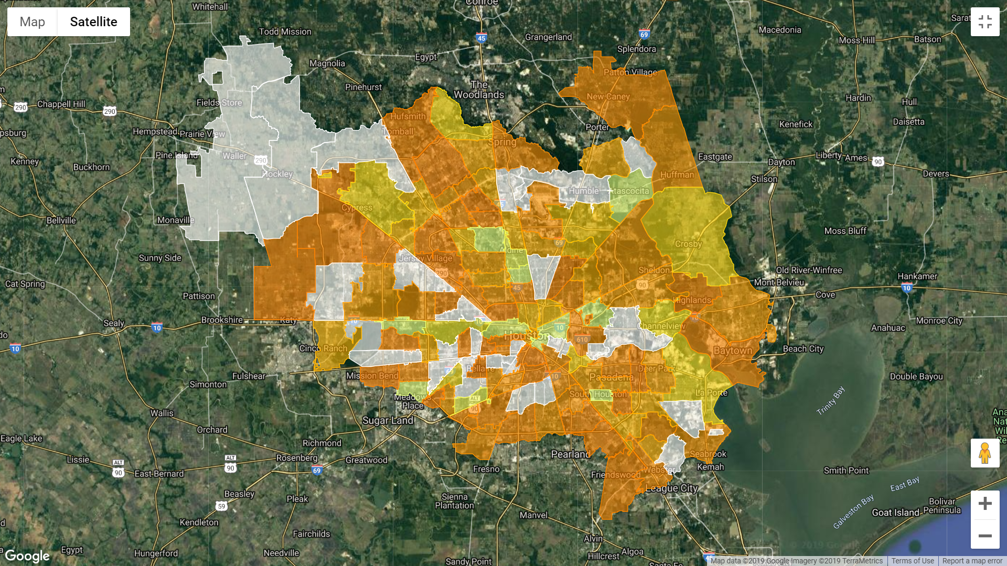
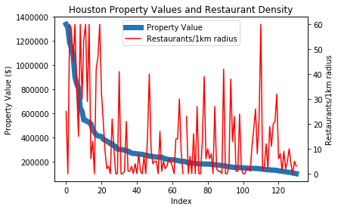
Restaurant Density
Correlation Coefficient: 0.47
weak positive linear relationship between property value and restaurant density
Highest restaurant density in central Houston and in some periphery

Slide 8
Final Insights

